Slide 1

ADVISOR
STUDENT
Dr. Eng. Dhany Arifianto, ST., M.Eng
Muhamad Haykal Hanif Gifari Adi
02311940000154
Designing and Infrasound-based Early Warning System for Merapi Volcano

Slide 2



I
Timeline
No | Kegiatan | Bulan ke-1 |  |  |  | Bulan ke-2 |  |  |  | Bulan ke-3 |  |  |  | Bulan ke-4
 |  | 1 | 2 | 3 | 4 | 1 | 2 | 3 | 4 | 1 | 2 | 3 | 4 | 1 | 2 | 3 | 4
1. | Data Ingestion
2. | Data Exploration and Understanding
3. | Data Pre-Processing and Feature Engineering
4. | Model Building and Selection
5. | Model Deployment
6. | Forecasting Solution Acceptance
7. | Report Writing

Slide 3
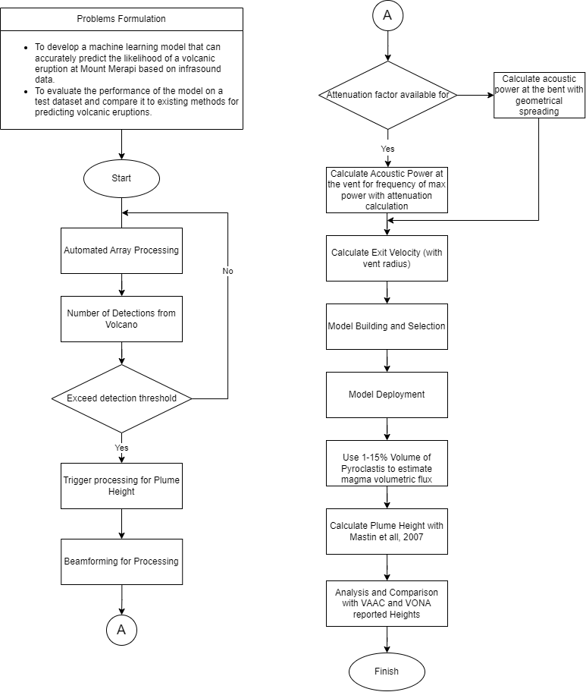
I
Timeline

Slide 4
IV
Data Preprocessing
Association
BISL
Events are identified using a pair-based Bayesian algorithm that defines the association between detection pairs from their joint-likelihood and identifies events via hierarchical clustering analysis
Evaluation using a synthetic data set shows some mixing of spatially similar events poorly resolved by network geometry and occasional inclusion of “noise” detections in event clustering
Event analysis using the Bayesian Infrasonic Source Localization (BISL) methodology to estimate both the spatial location of the event as well as the origin time with quantified uncertainty
Preliminary analysis of the back projections can be used to define the spatial region of interest or it can be specified by the analysis
Analysis identifies the maximum posteriori solution
Likelihood definitions relating detection parameters to spatial and temporal source characteristics are shared between association and localization analysis for consistency

Slide 5
IV
Model Building
Feature Engineering
Deep Learning Model
10 segments, 53 features that would be used for the model
Temporal characteristics: mean, var, amplitude, quantiles, rolling gradient amplitude, number of peaks (using tsfresh), autocorrelation, zeros-cross rate
Frequential features: mean/var/amplitude of imaginary and real parts of Fourier Transform.
Cepstral features: Mel-frequency cepstral coefficients (20 coeff)
Spectral features: the spectral_contrast (7 coefficients)
All these features were calculated for each sensor (missing values set to -1) and saved as csv locally (90min to run for train + test sets).
LSTM layer followed by 3 Conv1D layers (param 128, 84, 64).
Then a flattening operation allows to send the data in 3 Dense layers (fully connected) (size 64, 32 and 1).
Only ReLu activation function is used.
The optimizer is Nadam with a learning rate of 5e-3, the loss is the MAE.
8 models trained of subsets of the training sets were averaged to give the final result

Slide 6



Thank You

